Slide 1


Slide 2
Stranger thing challenge
Challenge link :-stranger thing challenge
Challenge completed by :-Ranjeev Pandey
Linkedin Id:-Ranjeev Pandey
Tools Used:- My SQL, Powerpoint

Slide 3
About the challenge
In this challenge, we have 4 tables:-
Characters
Locations
Events
Relationships
Monsters

Slide 4
About the challenge
Using SQL we have to find out the following :-
Retrieve the names of the characters?
Find characters with age greater than 18?
Find events in Season 2?
Get details of the 'Mind Flayer' monster?
Retrieve characters and their associated events?
Calculate the total number of characters from each hometown?
Retrieve characters who were involved in events in Season 1 or Season 2?
Find the top 3 oldest characters?
Find the average age of characters in Hawkins?
Rank characters by age in descending order?

Slide 5
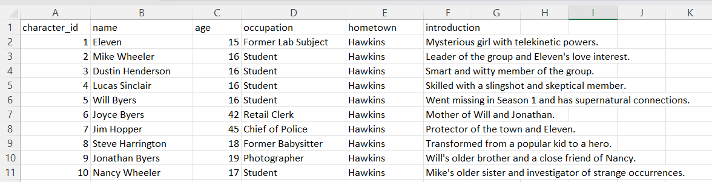
TABLES
Characters

Slide 6
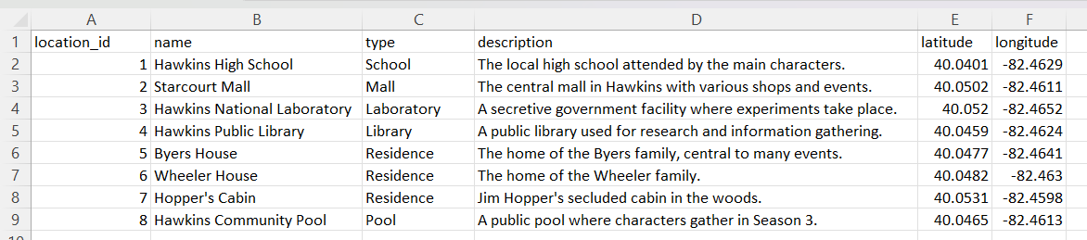
Locations

Slide 7
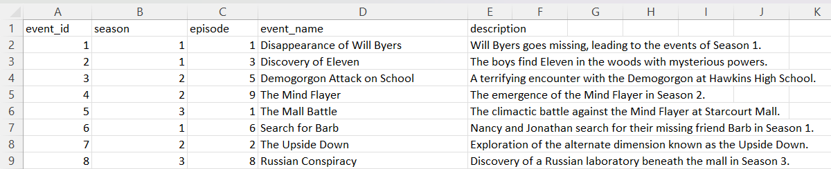
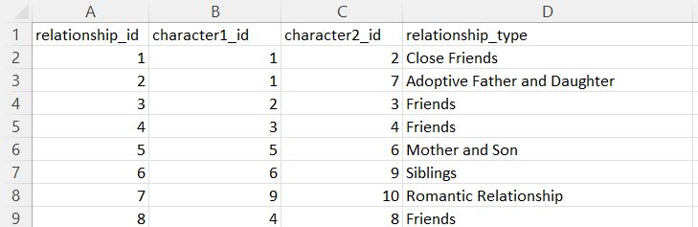
Events
Relationships

Slide 8
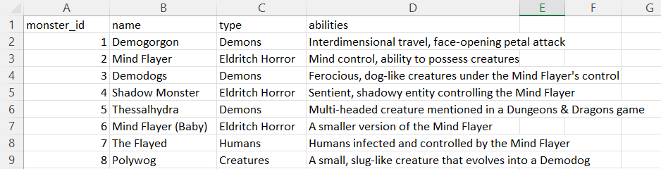
Monsters

Slide 9
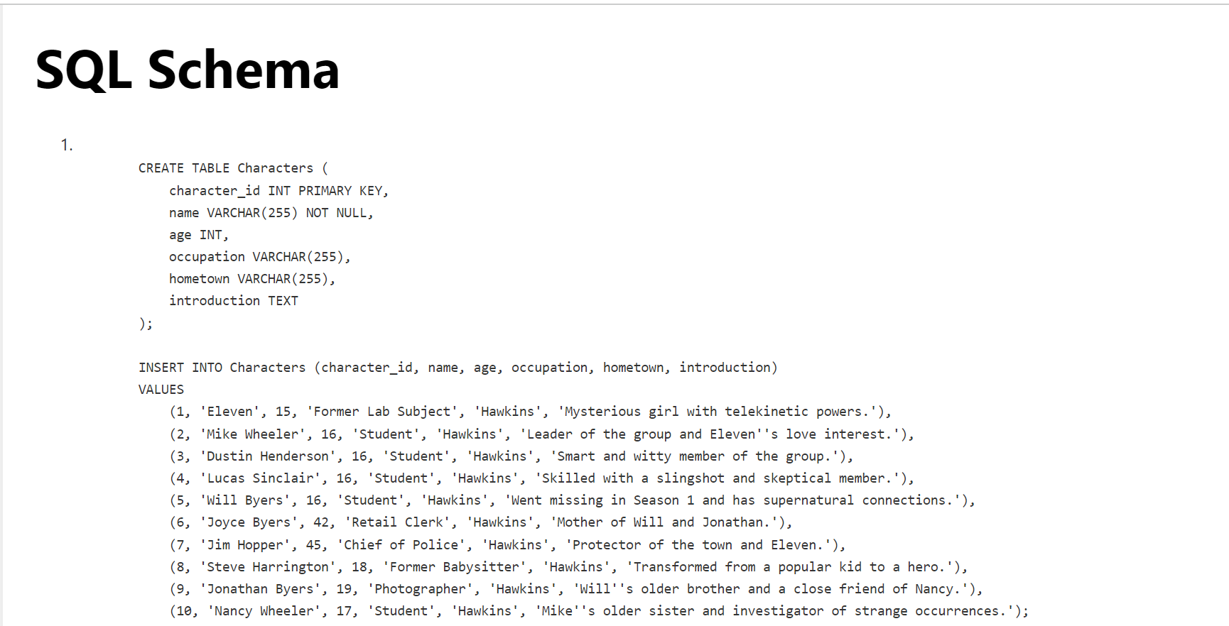

Slide 10
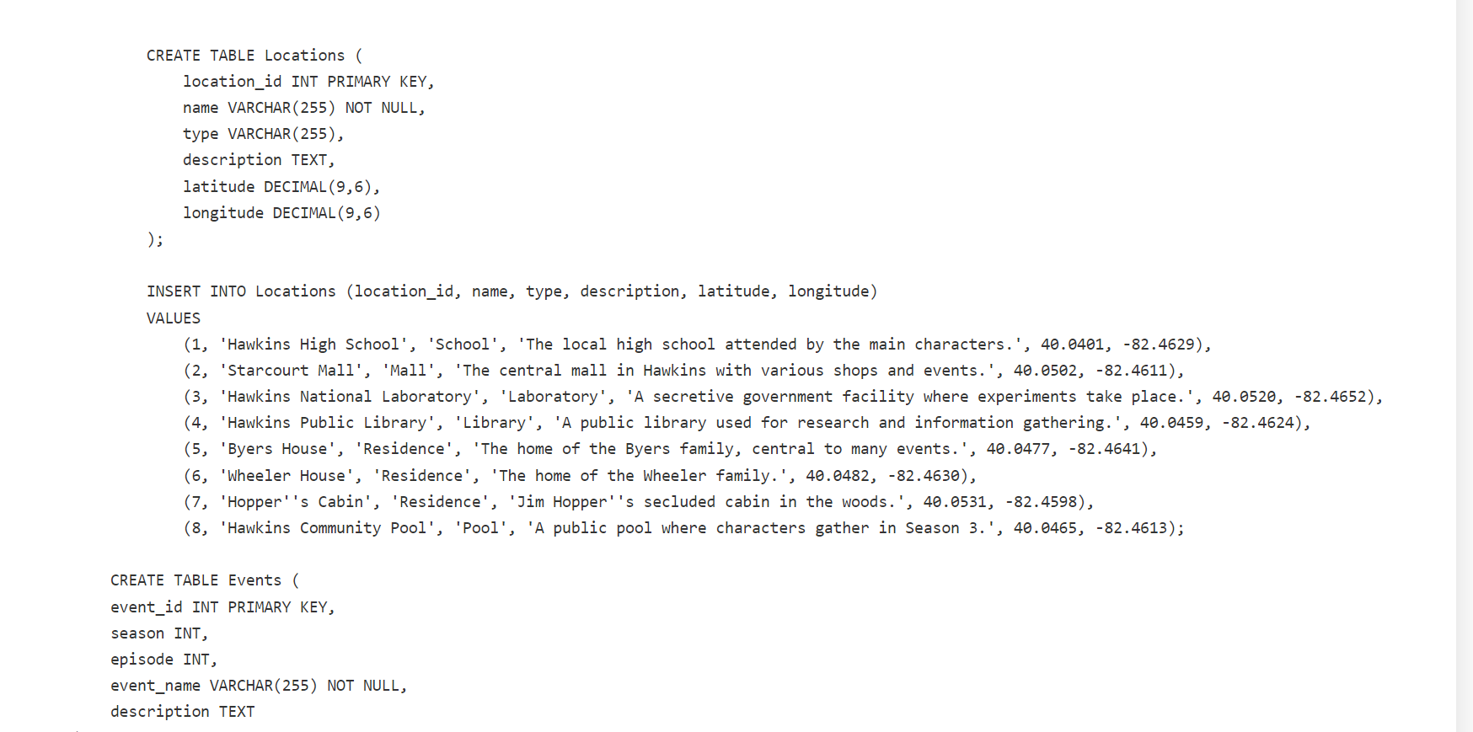

Slide 11
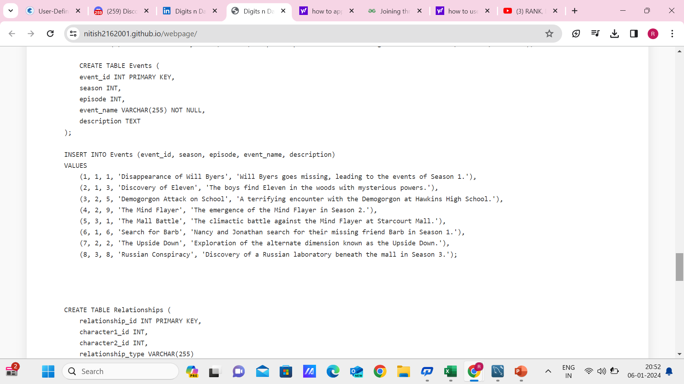
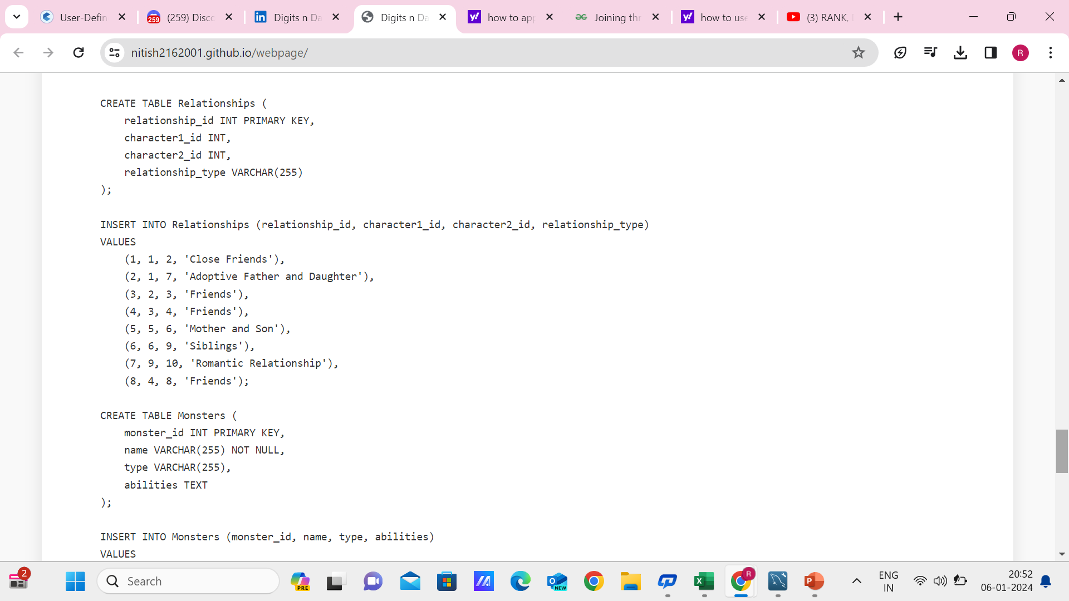

Slide 12
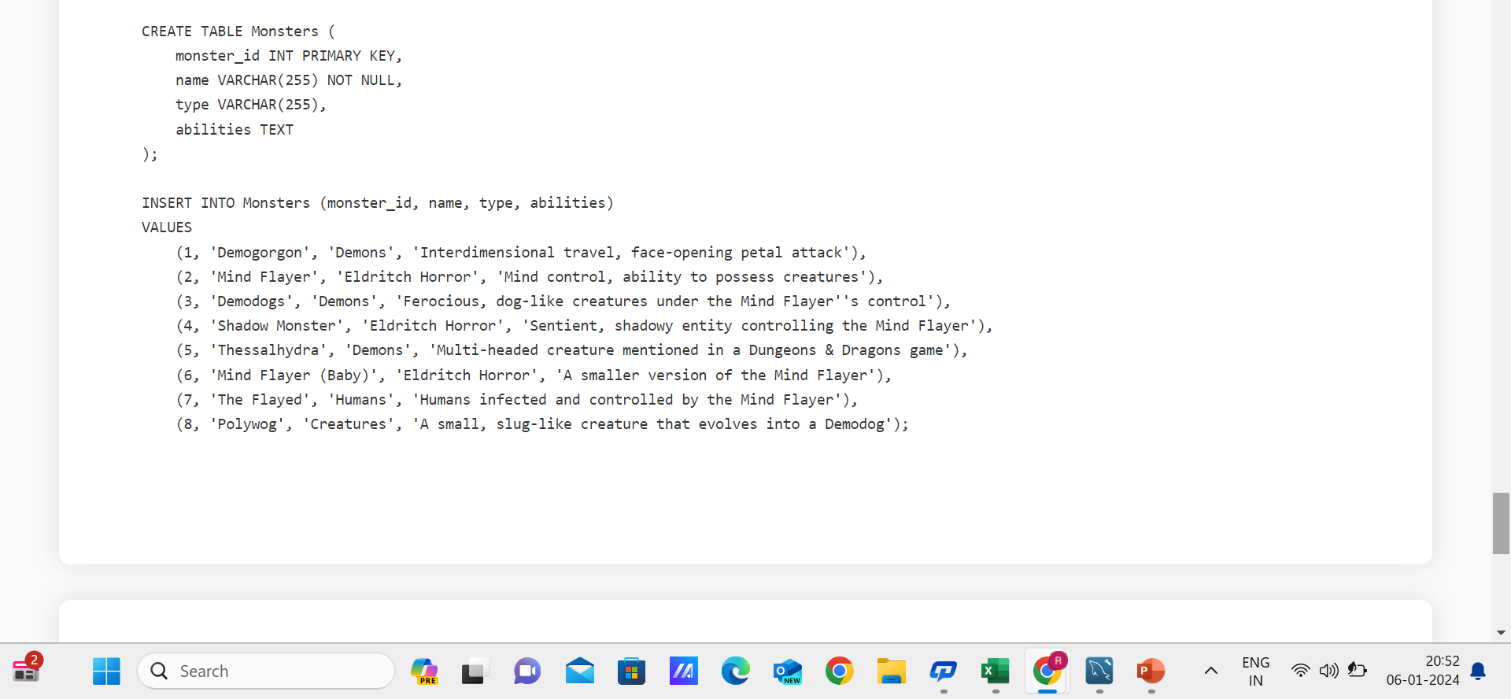

Slide 13
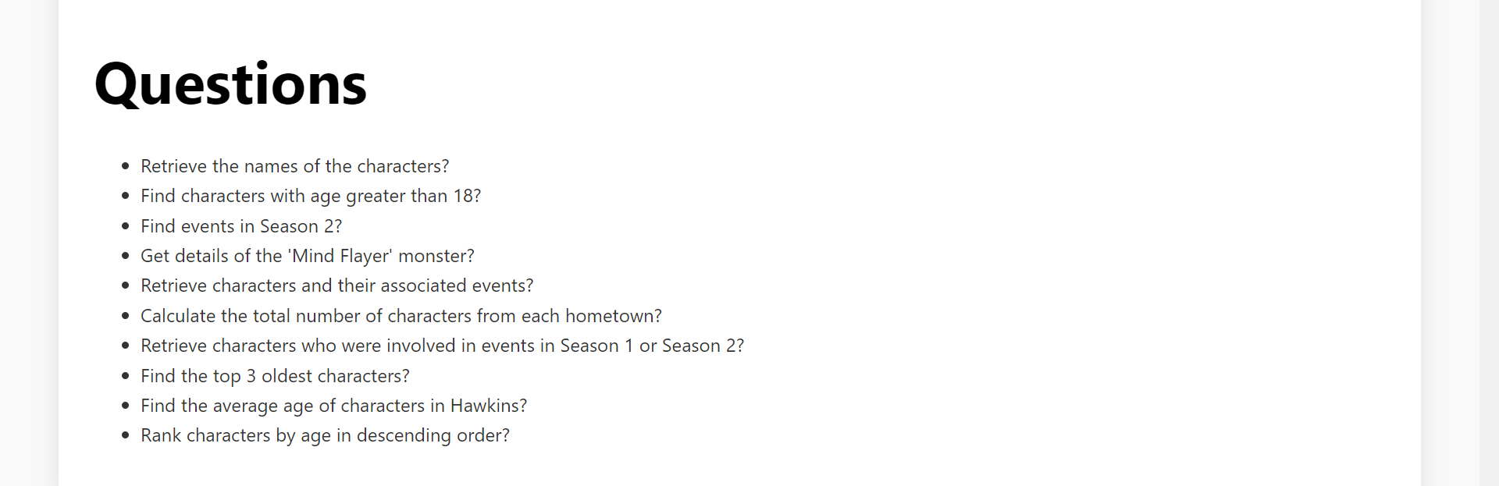

Slide 14
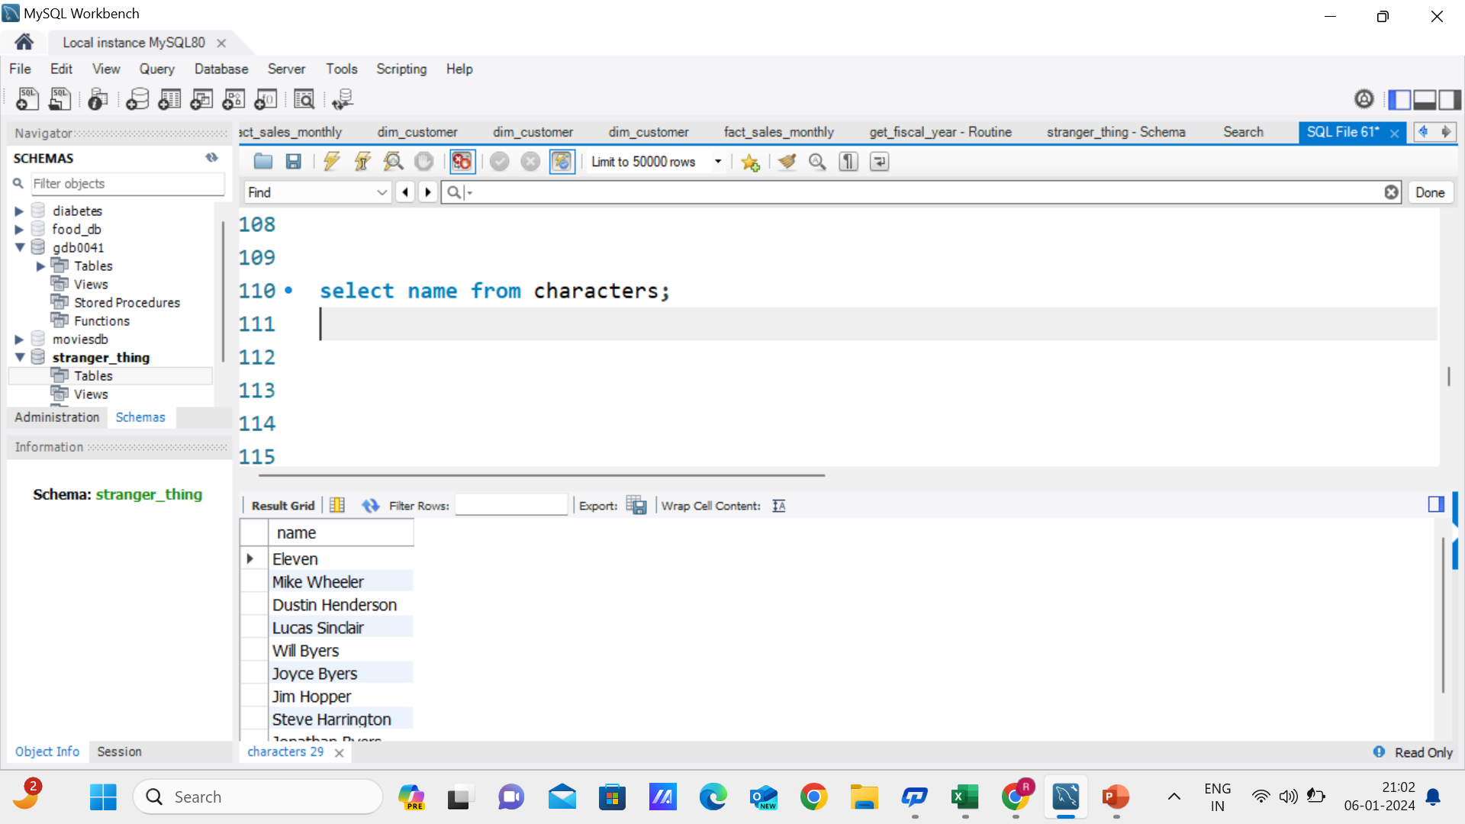
Retrieve the names of the characters?

Slide 15
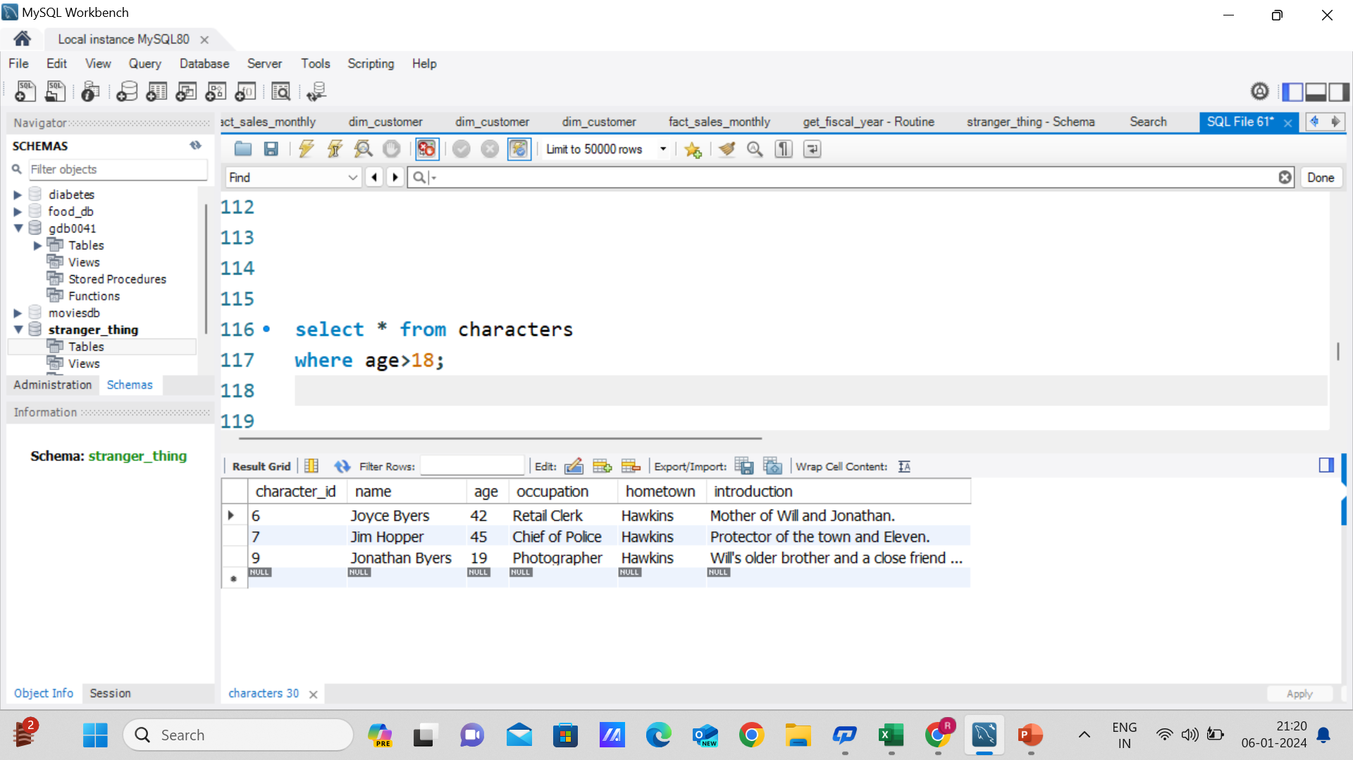
Find characters with age greater than 18?

Slide 16
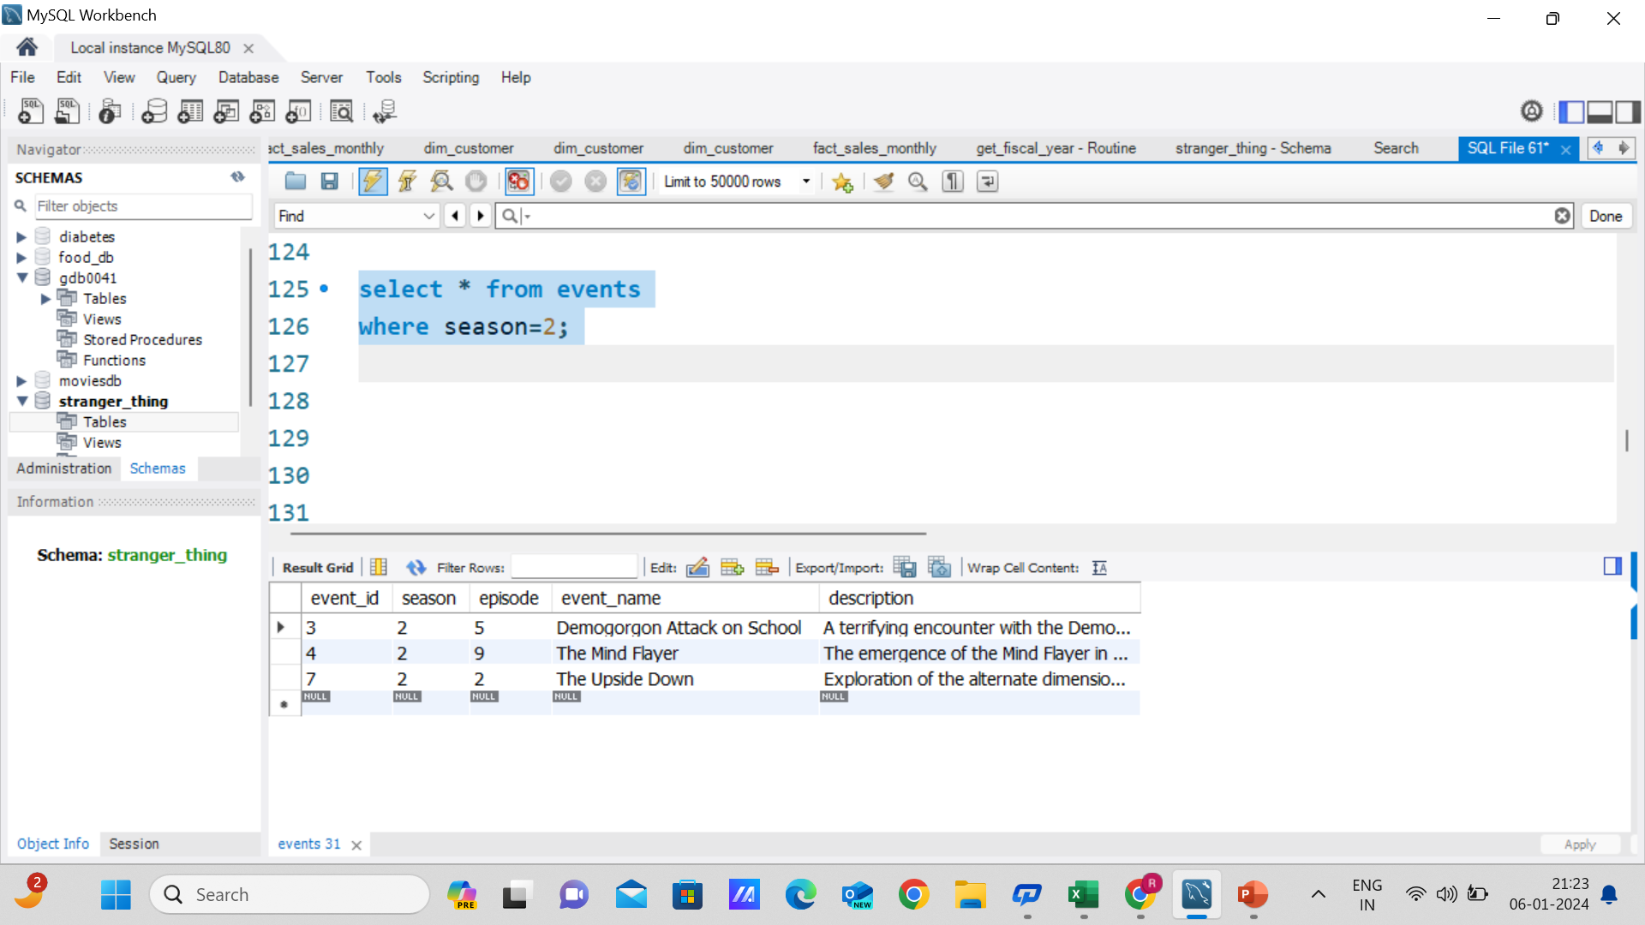
Find events in Season 2?

Slide 17
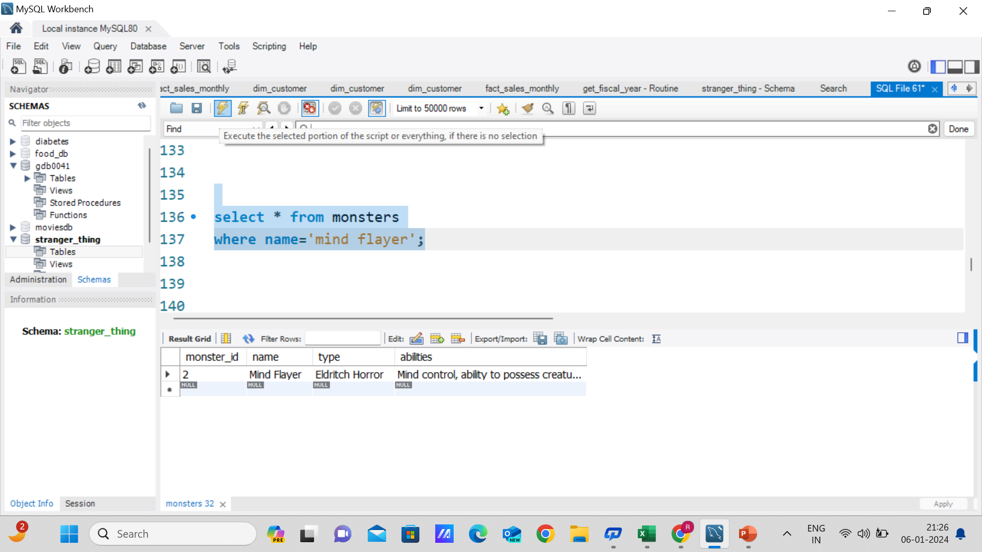
Get details of the 'Mind Flayer' monster?

Slide 18
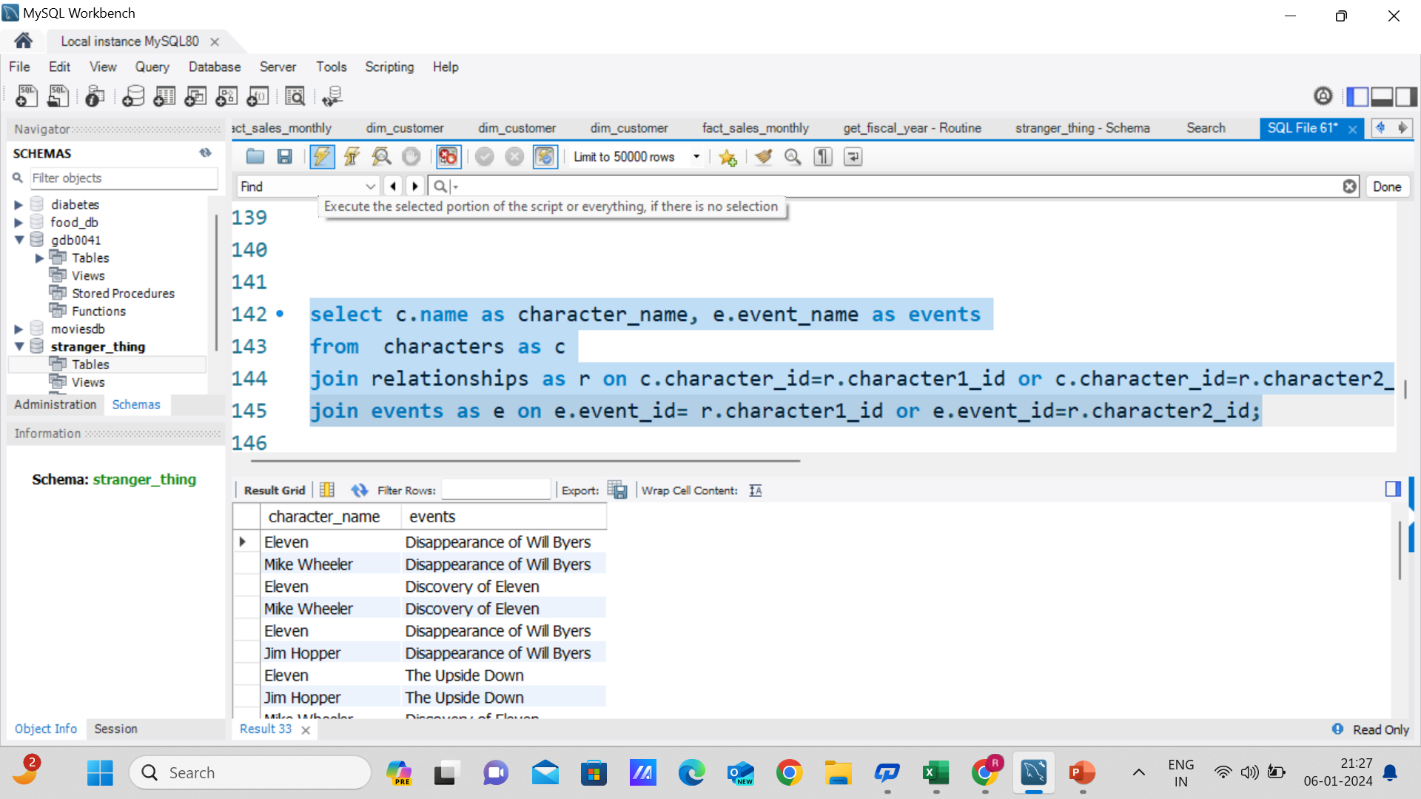
Retrieve characters and their associated events?

Slide 19
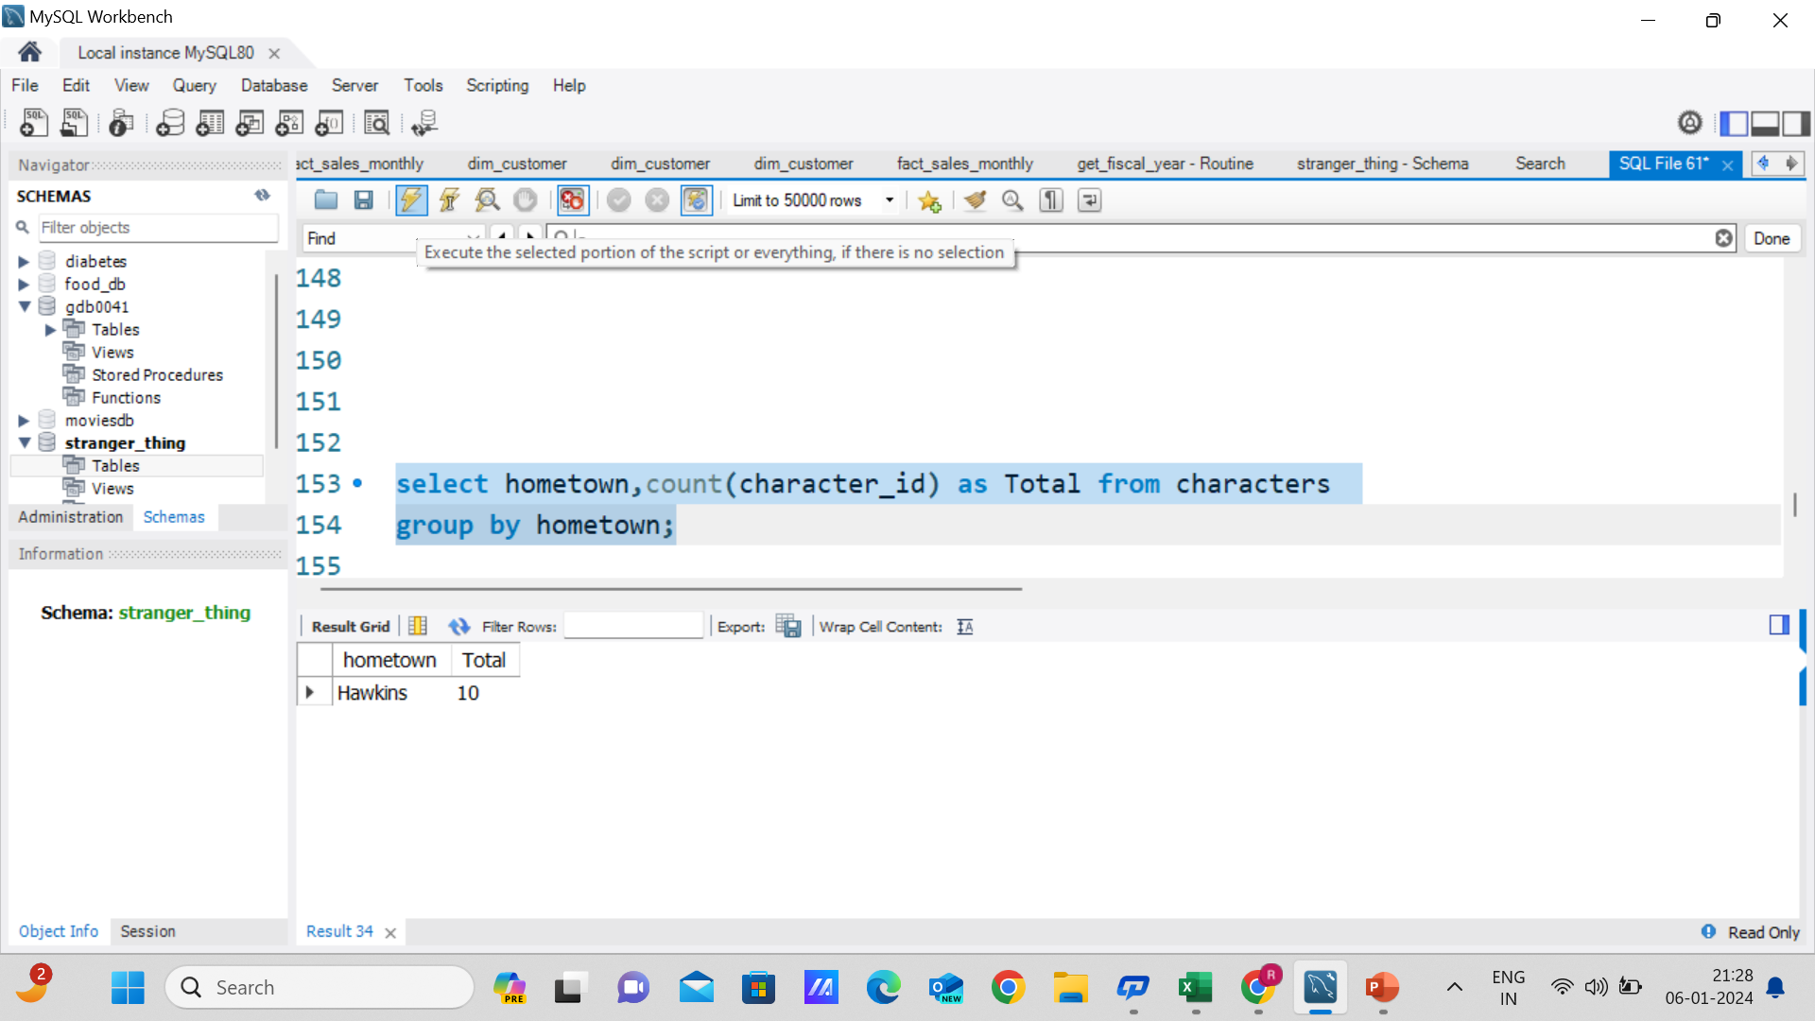
Calculate the total number of characters from each hometown?

Slide 20
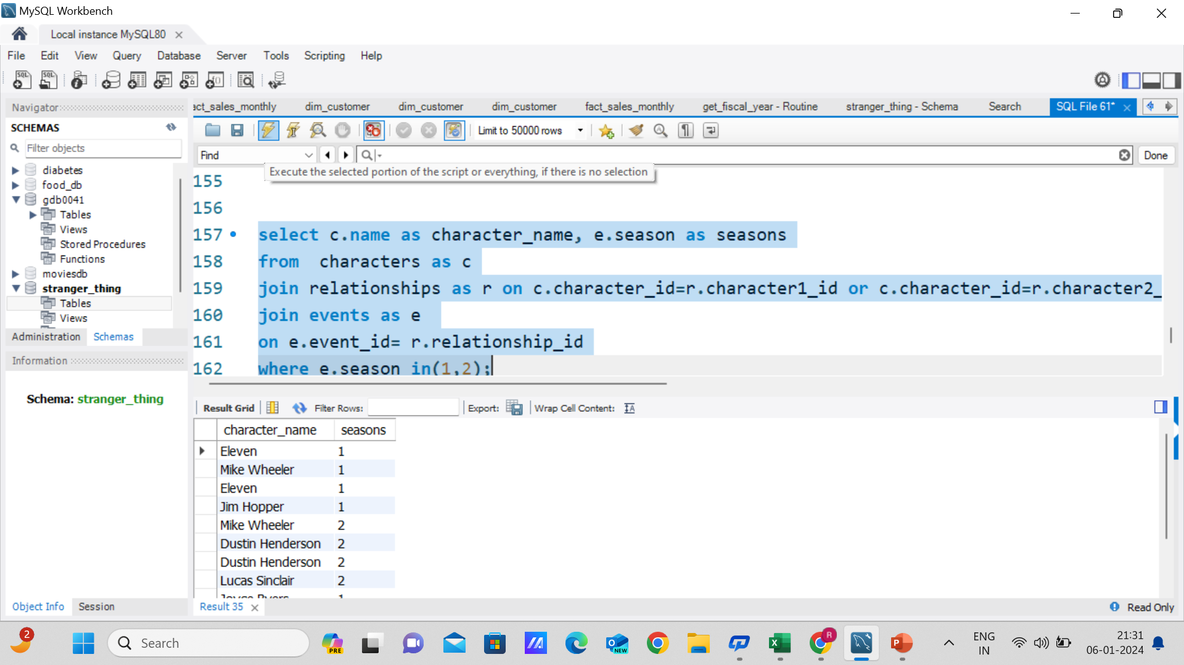
Retrieve characters who were involved in events in Season 1 or Season 2?

Slide 21
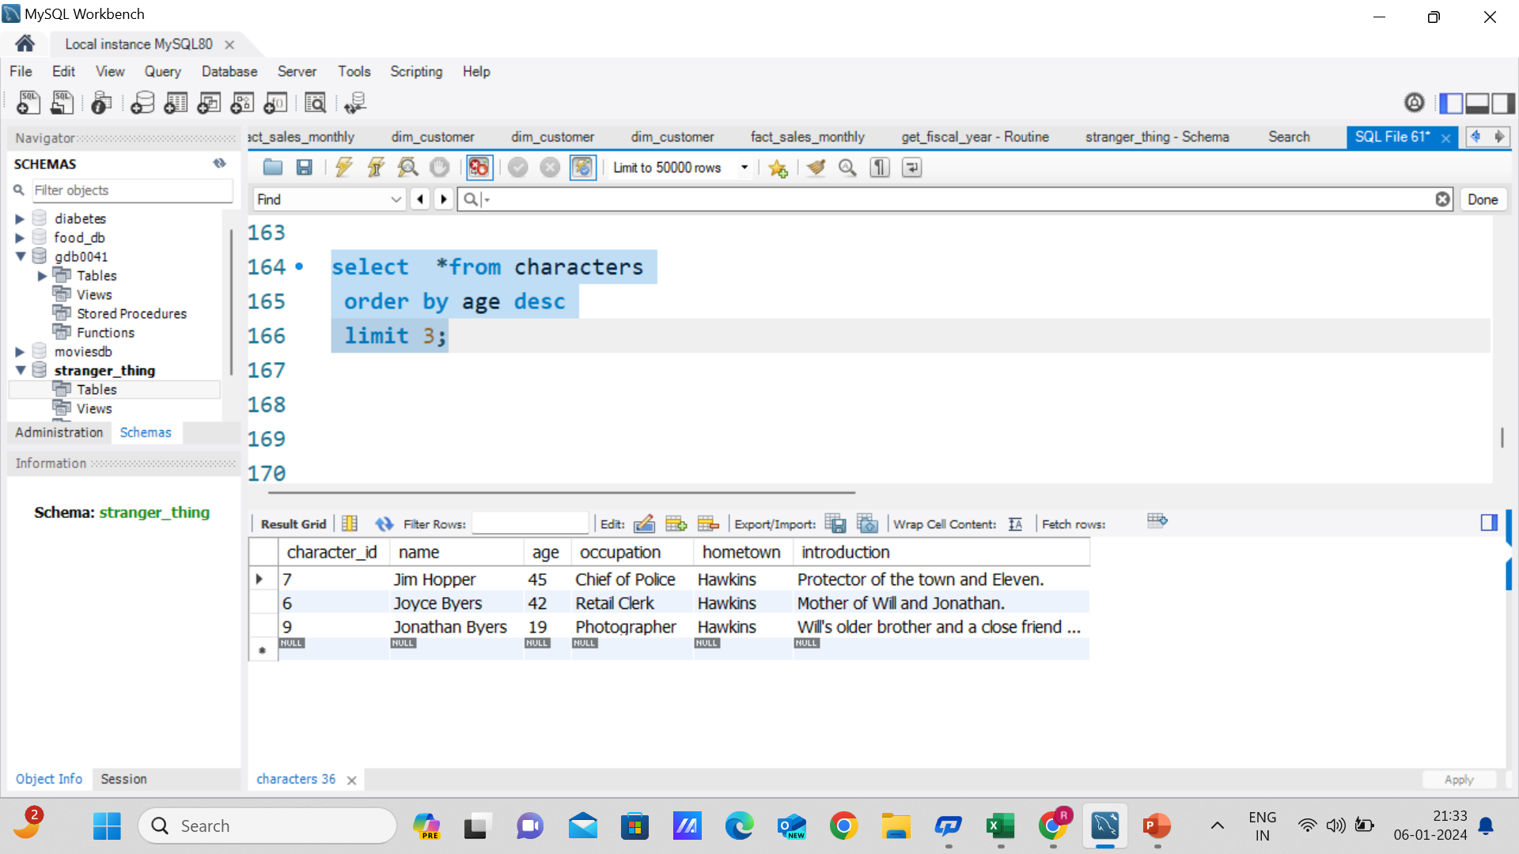
Find the top 3 oldest characters?

Slide 22
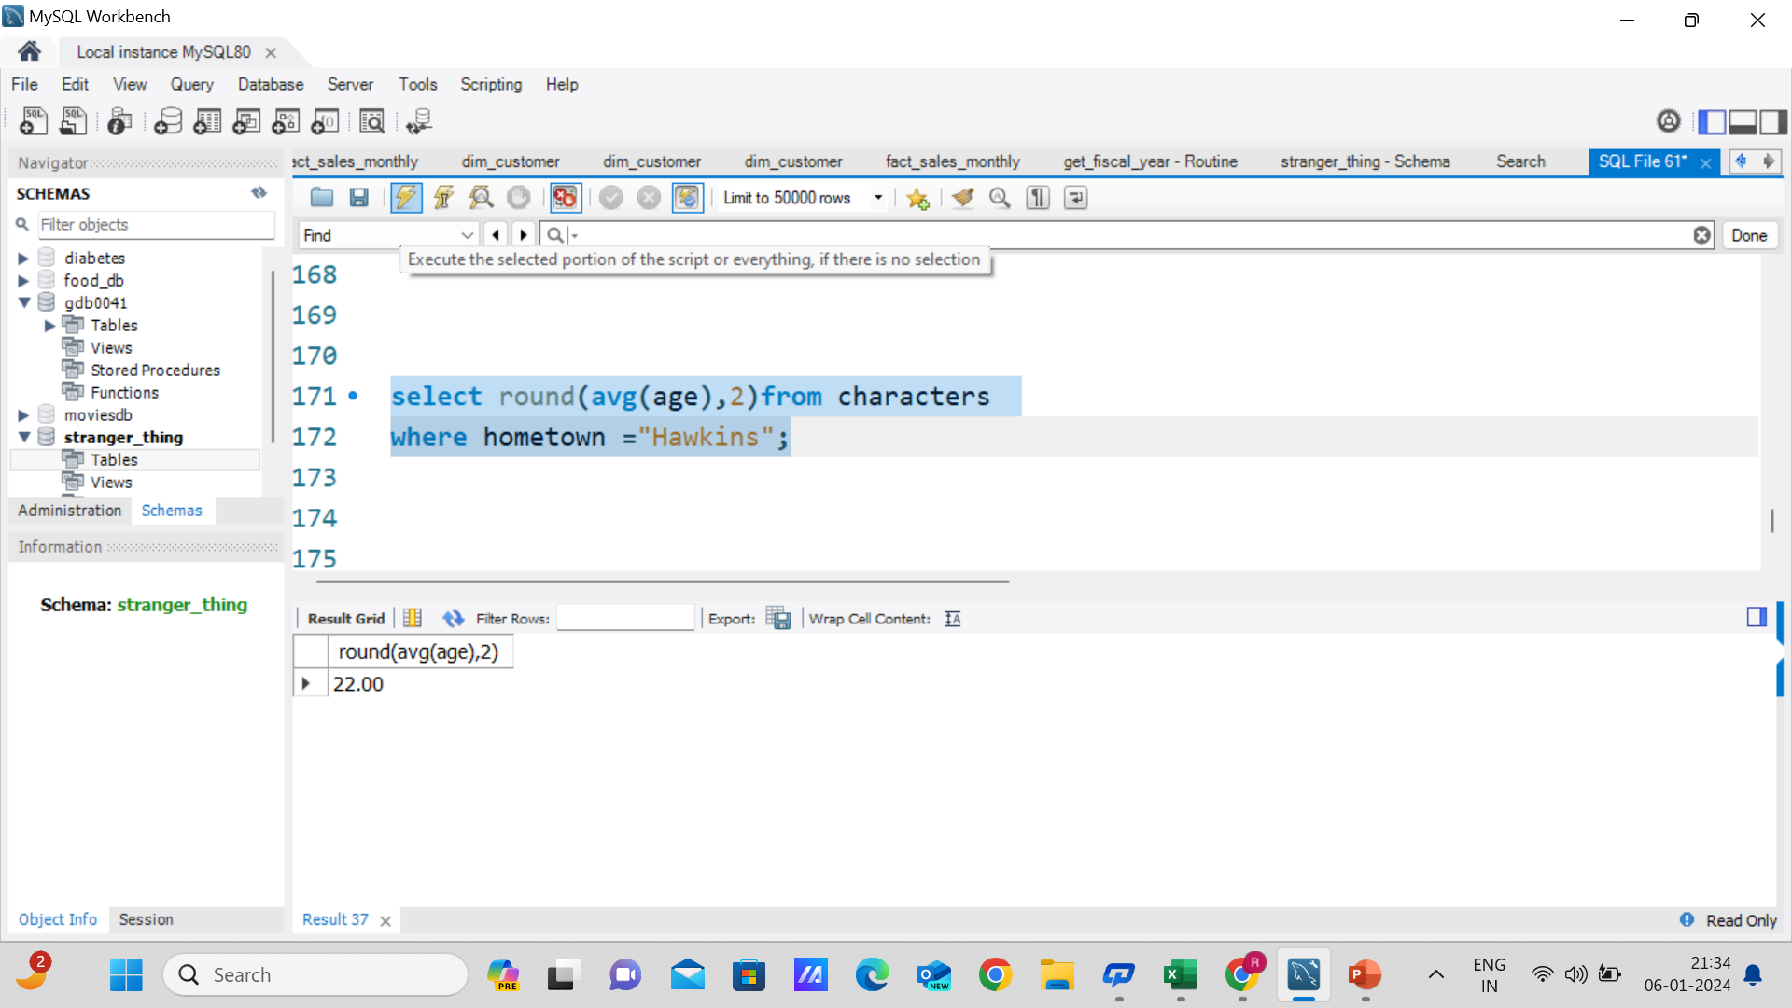
Find the average age of characters in Hawkins?

Slide 23
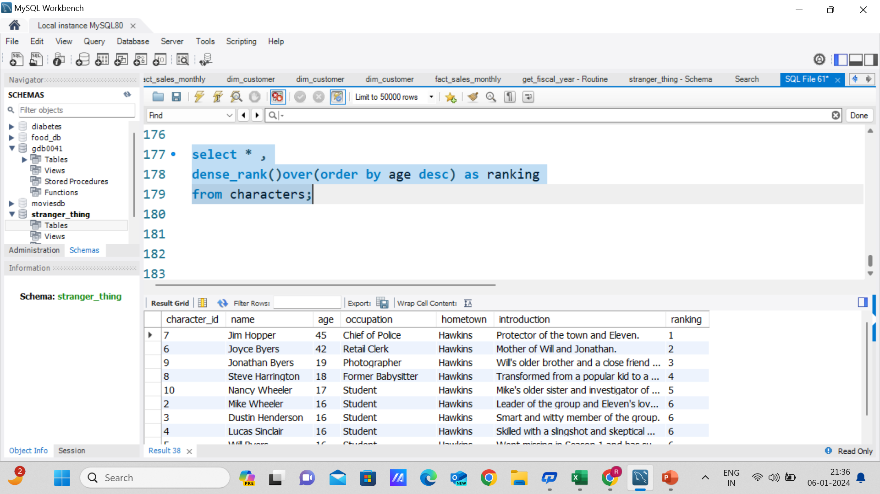
Rank characters by age in descending order?

